Slide 1
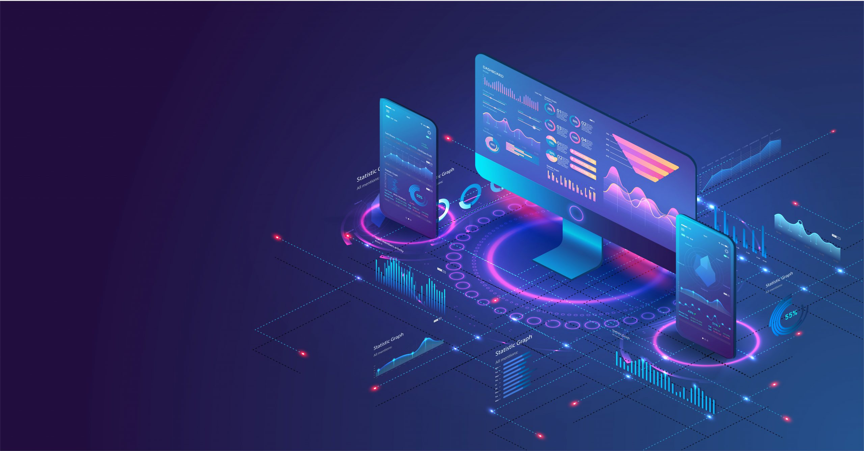
THE CONCEPT OF ECOSYSTEMS BASED ON DIGITAL PLATFORMS: BENEFITS, RISKS AND PRINCIPLES OF CREATION
Natalya N. MASYUK, Vladivostok State University, Vladivostok, Russia
Marina A. BUSHUEVA, Plekhanov Russian University of Economics, Ivanovo, Russia
Zinaida V. BRAGINA, Kostroma State University, Kostroma, Russia
Anna S. ILUKHINA, Kostroma State University, Kostroma, Russia,
Aleksandr A. BOGOMOLOV, Vladivostok State University, Vladivostok, Russia

Slide 2

ABSTRACT
The digital economy, represented by new technologies, is rapidly developing and is increasingly being integrated into all spheres of the economy and society.
The concept of ecosystems based on digital platforms is increasingly in demand by researchers to explain the processes taking place in the economy of enterprises, regions and countries in connection with the rapid development of digital technologies.
Each platform is based on a very simple idea: to organize interaction between the producer and the consumer in the digital space.
The modern economy is largely of an intermediary nature, since digital platforms carry the semantic load of organizing the interaction between suppliers and consumers.
The expediency of the transition to the platform business and the inevitability of embedding in the ecosystem are argued. The risks of using platforms are identified. The principles of creating a platform business are formulated.
02

Slide 3
INTRODUCTION
In recent years, the Internet, big data, cloud solutions, artificial intelligence, waiting and other technologies have accelerated innovation, becoming more and more integrated into the whole process of economic and social development.
The digital economy is developing at a rapid pace, has a wide range of observations and an unprecedented evaluation score, becomes a key vital need to transform serious resource factors, change the global economic structure, and change the global competition pattern.
An important role in the development of the digital economy is played by digital platforms.
A platform as a business is an association of two or more active parties to participate in achieving the goals of each group. From the point of view of the economic essence of this phenomenon, the digital platform acts as an intermediary.
03

Slide 4

METHOD AND METHODOLOGY
The methodological basis of the study is a comparative content analysis of global trends in the field of ecosystems and platform solutions, as well as a conceptual approach to the development of ecosystems based on digital platforms and the study of the opportunities that digital platforms provide to users, businesses and the owner of a digital platform, taking into account network effects.
04

Slide 5

RESULTS
Platform business models and ecosystems have become an objective reality of the digital economy.
The development of digital platforms leads to the formation of ecosystems.
The concept of an innovation ecosystem has not yet been specified, and the content of the various defined options depends on whether the concept of one or the other is being discussed, for example, in a business or spatial presence.
Although an ecosystem can exist without a digital platform, their presence significantly increases its productivity and activates the network interactions of its participants.
05

Slide 6

WHY IT IS FAVORABLE TO JOIN THE PLATFORM?
Each platform participant receives the value for which he came to the ecosystem.
Let us consider in more detail the tripartite cooperation of the platform participants and the motivation of each of the parties.
06

Slide 7
WHAT DOES THE CONSUMER GET?
a large selection of providers on the platform. A wide range of assortment makes it possible to choose more attractive conditions;
many searches tool. Various filters, selections, etc.;
risk mitigation through the operation of the platform in terms of checking the reputation of suppliers. It is beneficial for the platform that only reliable suppliers work on it. Any negative due to the supplier also affects the platform.
free elements for the consumer - due to the fact that the platform earns on other services. For example, Google searches for information for free, Facebook gives you the opportunity to communicate for free, AliExpress gives you the opportunity to quickly pick up the right product from a trusted supplier for free without having to go anywhere.
07

Slide 8

WHAT DOES THE BUSINESS GET FROM THE PLATFORM?
Business gets access to narrow segments of consumers who have a formed need.
Clients come with their requests.
The platform must correctly redirect this interest to suppliers that can meet this demand. Business does not need to spend money on marketing and promotion of goods. This is done by platform services.
The business must place its goods and services, and the task of the marketplace is to bring the consumer to these services.
A business can receive additional digital services for its work. For example, it could be a CRM to track time bookings when signing up for services, or it could be a complex services calculator.
A business can reduce risk when working with a client. The platform guarantees the business that it will receive money while performing its duties. An example is a safe transaction on freelance exchanges.
08

Slide 9
WHAT DOES THE PLATFORM GET?
A
Low cost of resources to provide services.
The ability to grow quickly. A platform business can grow rapidly - the costs of growth are relatively low. At the same time, there are great opportunities for experimentation - changing the interface of the site is easier than remodeling the building. The digital world is a more malleable material than the real one. At the same time, any action on the site leaves a trace that can be analyzed. This allows many growth hypotheses to be made and tested.
The ability to study information on the interaction of market participants and make decisions on optimizing these interactions also plays an important role for the platform owner.
The platform owner has the opportunity to provide a more complete service to the consumer. It is easier for the platform to build a whole line of services for the buyer, which will cover the spectrum of needs.
B
C
D
09

Slide 10
PRINCIPLES OF THE FUNCTIONING AND DEVELOPMENT
OF DIGITAL ECOSYSTEMS AND PLATFORMS (1)
01
security of the digital environment;
seamlessness of tools and support mechanisms;
preferential conditions for the conduct of activities by national market participants over foreign ones;
prevention of regulatory and tax arbitrage, including in favor of foreign platforms and ecosystems;
healthy competition between national ecosystems/platforms;
transparency of the conditions for consumer access to the services of the digital ecosystem and platform, which do not allow unlimited discretion of the owner of the ecosystem;
10

Slide 11
PRINCIPLES OF THE FUNCTIONING AND DEVELOPMENT
OF DIGITAL ECOSYSTEMS AND PLATFORMS (2)
02
freedom of transition of users between digital platforms, ecosystems;
freedom of disposal by users of their data stored and processed by the digital platform, ecosystem;
preventing platforms and ecosystems from imposing their own services, creating discriminatory conditions;
avoidance of restriction of consumer's choice;
openness;
balance of mutual interests
11

Slide 12
CONCLUSION
The concept of platform-based ecosystems opens up new possibilities for information technology-based platform management and ecosystem management.
This is a new significant contribution to management that has been obtained as a result of the application of the ecosystem concept.
Platforms contribute to the collaboration of all participants, increase the efficiency of ecosystems through more intensive and productive interaction of all economic agents located on the platform.
From the point of view of a platform as an ecosystem centered on interactions among participants, the process and performance of value creation are not only direct business performance such as sales and profit, but also the size and scope of the user base and the degree of commercialization of ideas.
A very important asset of the platform is the community and the resources that its members possess. T
Thus, the focus of the strategy shifts from resource control to resource coordination, from optimizing internal processes to facilitating external interactions, and shifts from expanding customer value to maximizing ecosystem value.
12

Slide 13
THANK YOU FOR YOUR ATTENTION!

